Slide 1

GLOBAL HACKATHON In JEJU
Food Waste Recycling
Made by 9 team [ Save The Food ]

Slide 2










Team Member
Introduce Ourselves
Food Recycling Team
Juhyeon Kim
Kyungse Park
DongGuk University, Korea
Hanyang University , Korea
Taehyoung Kwon
Nahyun Sung
KwangWoon University, Korea
Kookmin University, Korea
Park Goeun
Sanghyo Lee
Jeju National University
KwangWoon University, Korea

Slide 3
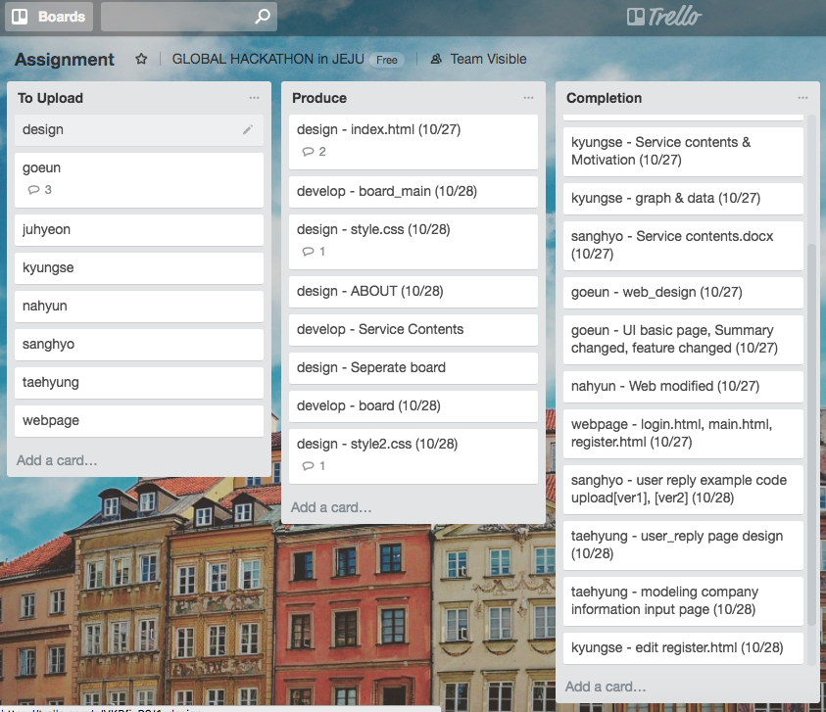
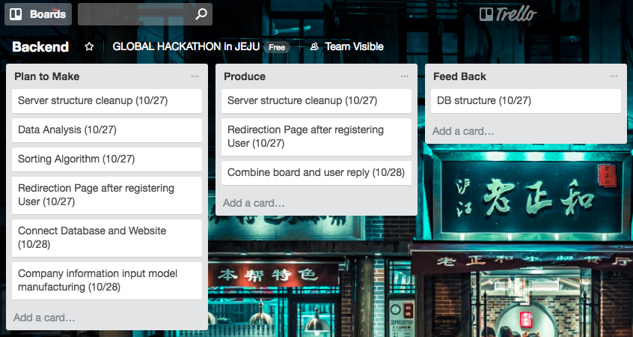
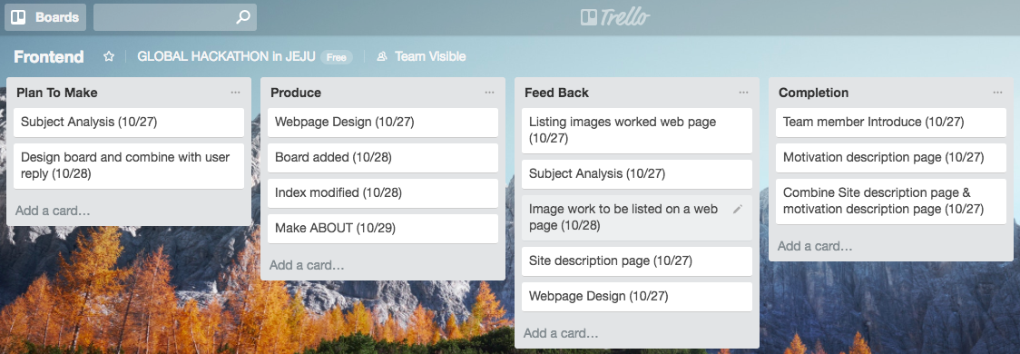
Our Team Schedule
Managed using Trello !

Slide 4
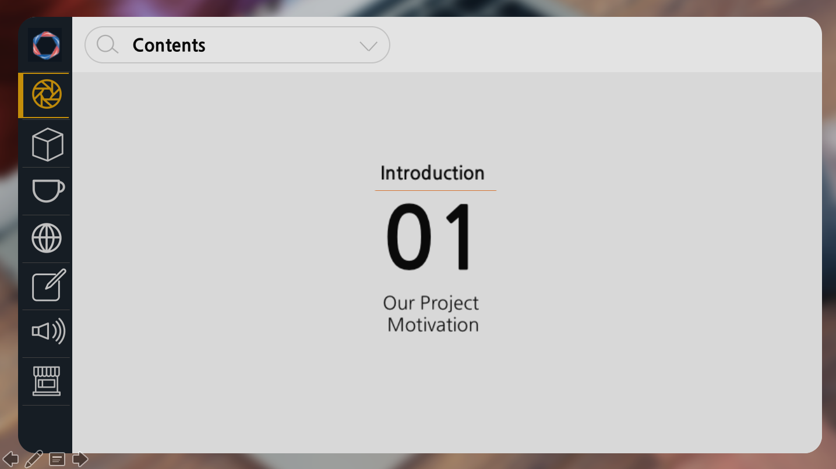
Contents
Introduction
Introduction
Project Detail
Prototype
Result
01
02
03
04
05
Our Project
Motivation
About
Our Project
Front/Back end
Machine Learning
Demo Movie
Current &
Future work

Slide 5
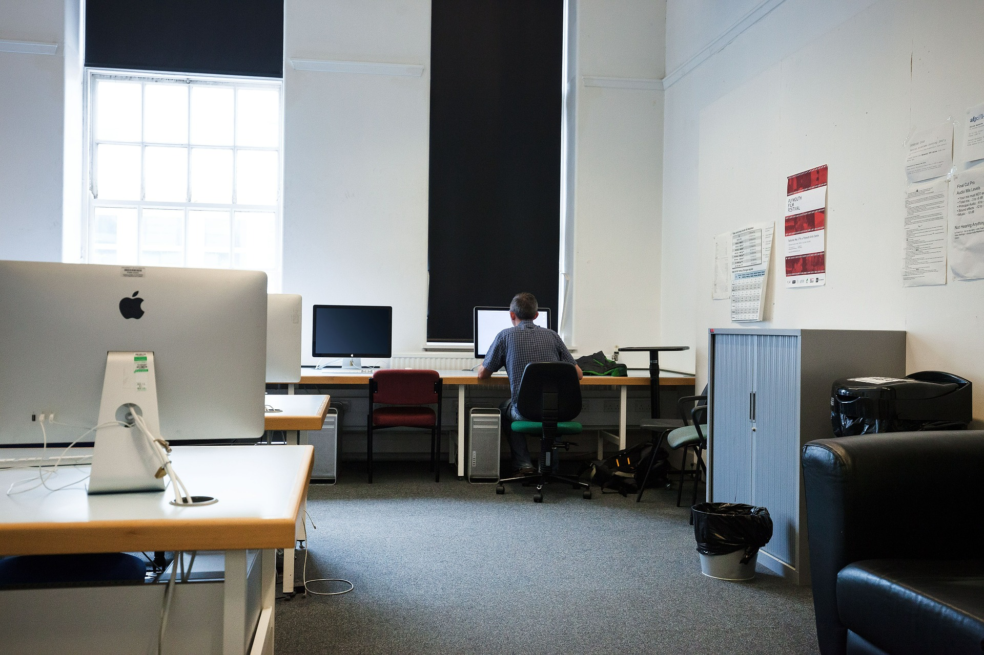
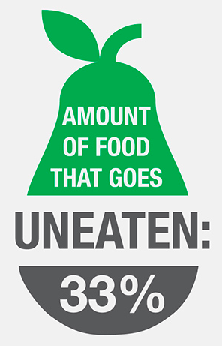
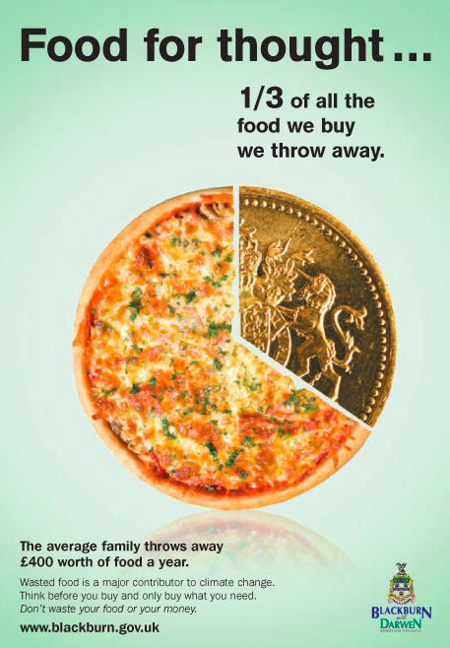
Project Background

Slide 6
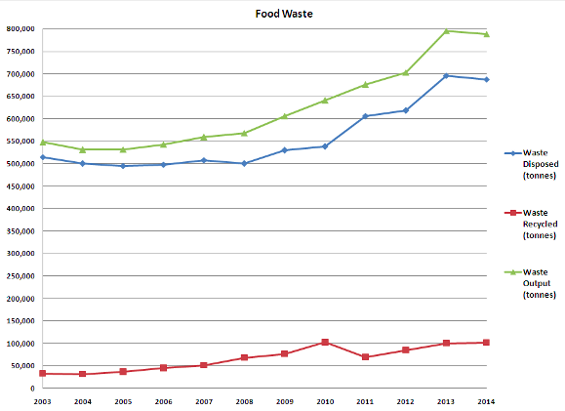
Project Background

Slide 7
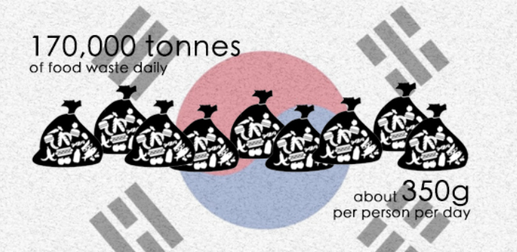
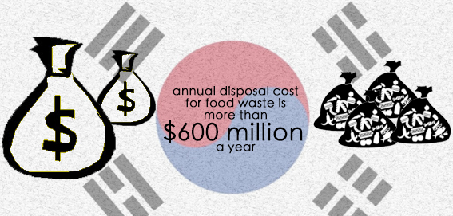
Project Background

Slide 8

Contents
Introduction
Introduction
Project Detail
Prototype
Result
01
02
03
04
05
Our Project
Motivation
About
Our Project
Front/Back end
Machine Learning
Demo Movie
Current &
Future work

Slide 9






Component
Smartphone
Desktop
Internet
Web Server
Database
Tablet

Slide 10
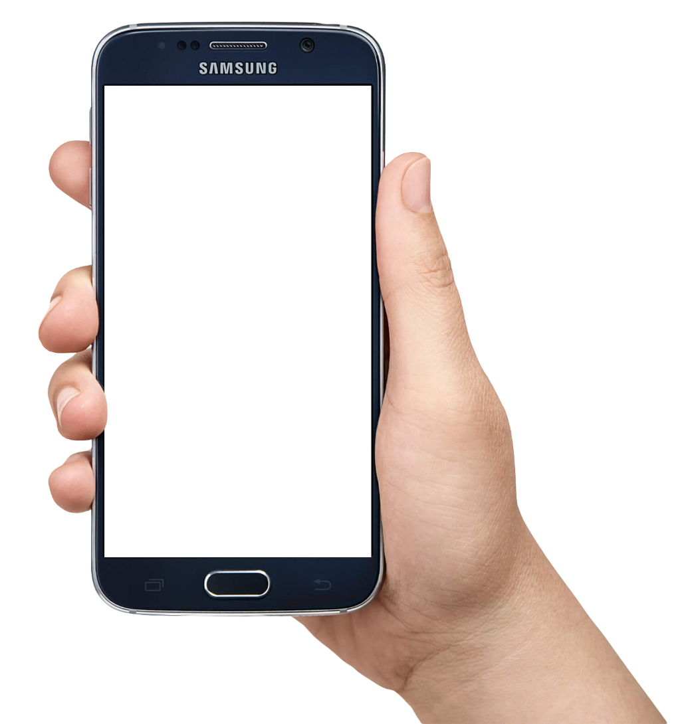
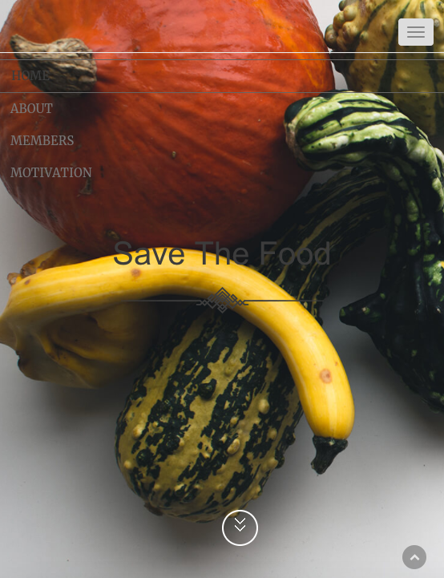

Introduction
About Our Project
Get credit
Restaurant owner
Upload product
Get Reasonably priced food
Give Evaluation of restaurants
consumer

Slide 11
Project Overview
Service contents
Producer
Can distribute whole food to be treated as food splinter
We provide country-level store support based on the amount of food distributed at each store
Raising awareness by food sharing service.
Become an eco-friendly shopConsumer
Consumer
Fresh free food can be obtained
Can have many experiences on food
Use of website services can have a positive impact directly on environmental protection

Slide 12


Business Model
Possible Structure
Our Company
First, 3 month free test period
Next, Get proper $ per month
Membership structure
Environmental Best Restaurant Award
If the restaurant has a lot of credits, give it a nameplate to increase its reputation.
Business Model = Membership
1️⃣
3 month
Free test period
If, restaurant want to keep going with us
Enviromental
Best Award
3️⃣
Proper $ per a month
2️⃣
Most Credited
Membership [ ex) Costco ]

Slide 13
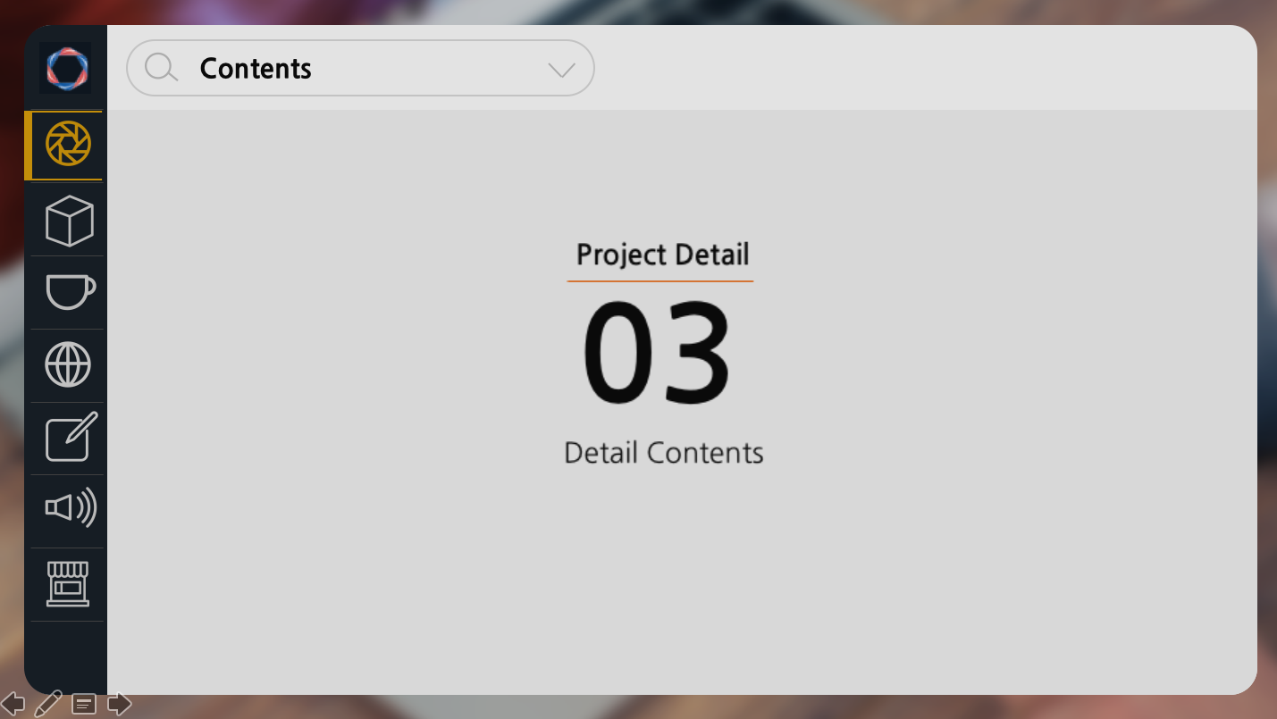
Contents
Introduction
Introduction
Project Detail
Prototype
Result
01
02
03
04
05
Our Project
Motivation
About
Our Project
Detail Contents
Demo Movie
Current &
Future work

Slide 14
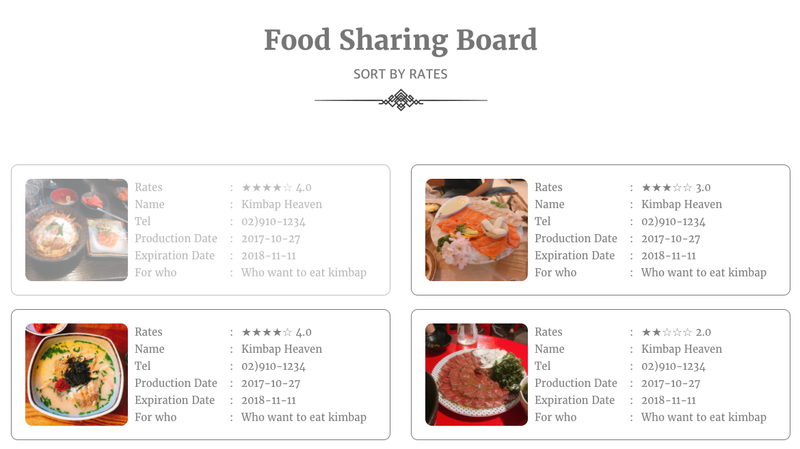
Project Detail
Customer View
Notes:
이미 팔린음식은 음영처리, 나머지는 판매되고 있는 음식들

Slide 15
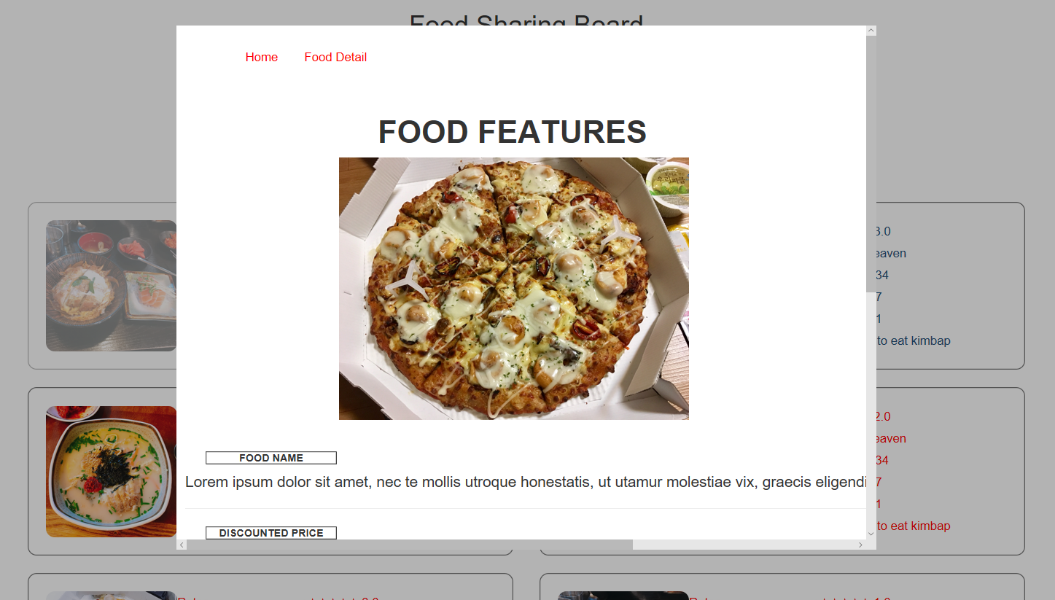
Project Detail
Customer View ( Details )
Notes:
슬라이드로 여러장의 사진이 바뀌며 상세 정보가 들어있다

Slide 16
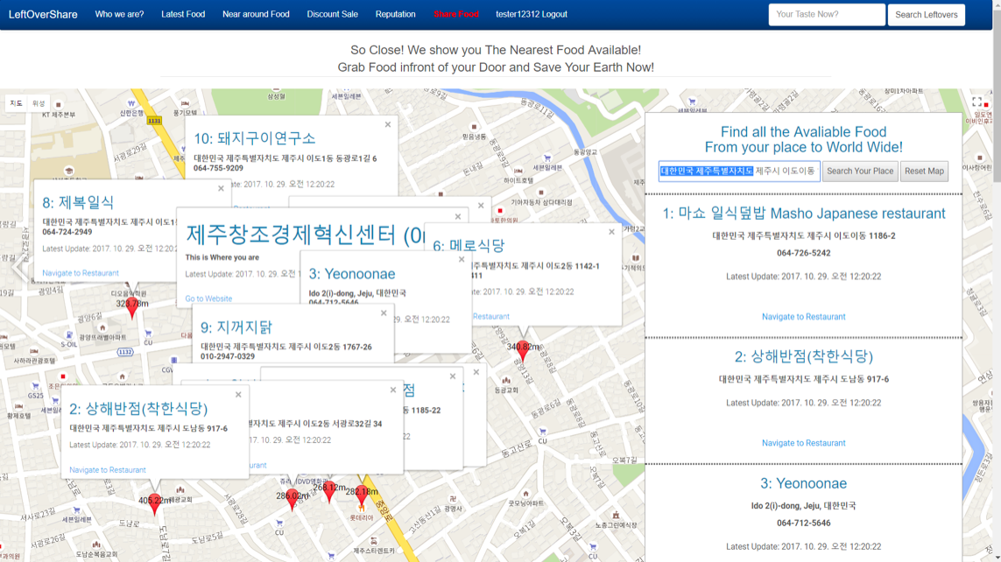
Project Detail
Customer View ( Nearest restaurant )
Notes:
슬라이드로 여러장의 사진이 바뀌며 상세 정보가 들어있다

Slide 17
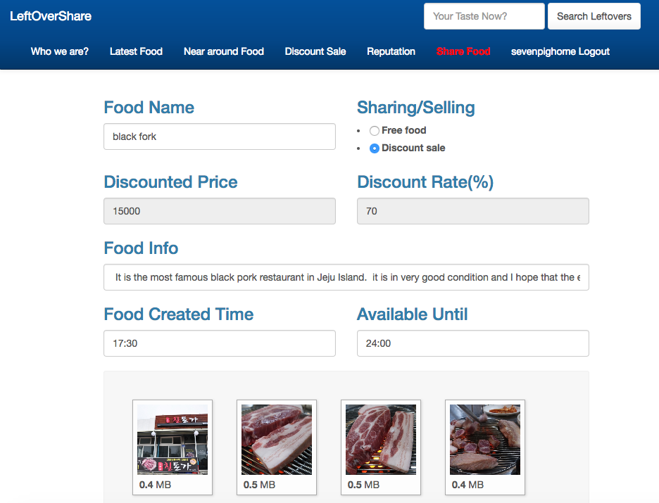
Project Detail
Restaurant owner Register View
Notes:
슬라이드로 여러장의 사진이 바뀌며 상세 정보가 들어있다

Slide 18
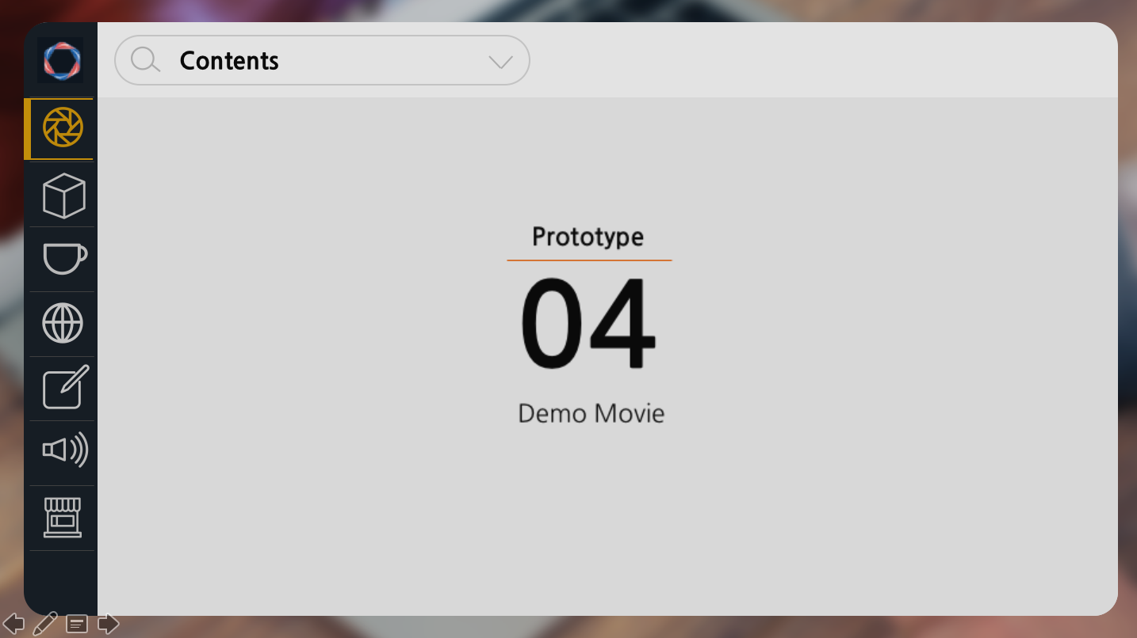


Contents
Introduction
Timeline
Project Detail
Prototype
Result
01
02
03
04
05
About
Our Project
Our Project
Motivation
Detail Contents
Demo Movie
Current &
Future work
Notes:
Fourth, let me show you the prototype we created.

Slide 19

Expectancy effects
Consumers - Get the food at a cheap price.
Seller - Reduce food waste disposal costs & make profits.
Help hungry neighbors.
Reduce food waste disposal budget.
Solve environmental pollution problems.

Slide 20




Current & Future Works
Current Work
Completed Prototype
Create Business Model
Test Server & DataBase
step03
Complete
Testing
Future Work
step02
Develop Commercial Version
Promote public advertisement
Agreements with governments (support for Best restaurants)
step01
Prototype

Slide 21

Thank you for your listening.
GLOBAL HACKATHON In JEJU
Save The Food 9 Team

